Slide 1
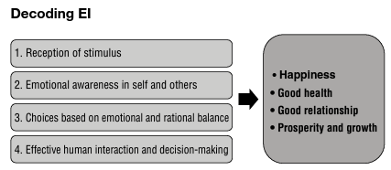
EI is the reception of a stimulus from the environment with an awareness of emotions in oneself and others which helps us make considered choices. It is about striking a balance between emotions and rationale, thereby positively influencing human interactions and decision-making.

Slide 2
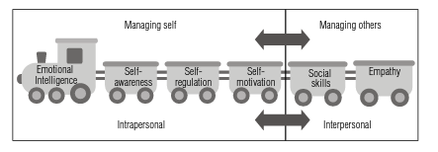
EI is a social–emotional competence. EI as a model can be broken into two broad aspects:
1. Managing self
2. Managing others
The Engine of EI

Slide 3
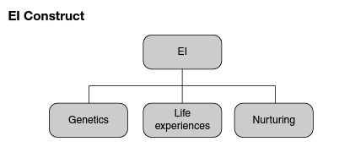
EI is both acquired and learnt. It can be built through a deep understanding of the lessons learnt from life experiences. On the other hand, genetics too play an important role in the development of EI. It is rather difficult to peg a percentage on the contribution of genetics and life experiences in the development of EI. With age and maturity, EI tends to get stronger.

Slide 4
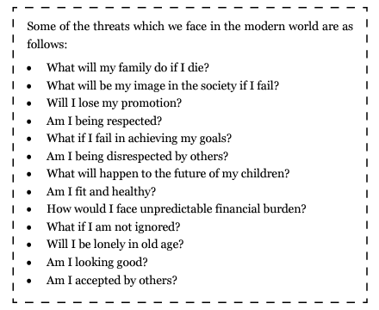

Slide 5
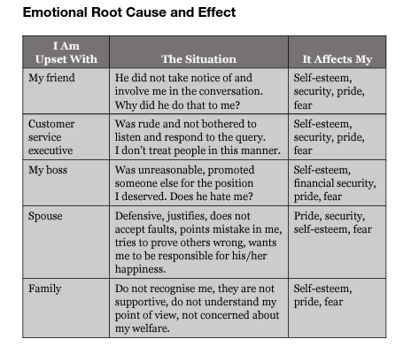

Slide 6
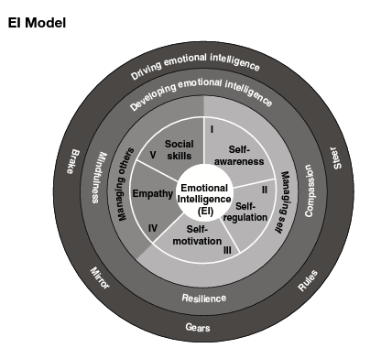

Slide 7
EMOTIONAL INTELLIGENCE; HISTORY, MODELS AND MEASURES
Emotional Intelligence in the simplest words refers to the ability to recognize and regulate emotions in ourselves and others [1] to make effective decisions [2], [3]. EI may be a relatively new term, not more than 25 years old but the roots of EI can be found in The Bhagavad-Gita, 5000 years ago where Krishna‘s Sthithapragnya (Emotionally stable person) is very close to Mayer and Salovey‘s Emotionally Intelligent person [4] and also the work of Plato, 2000 years ago where he stated, ―All learning has an emotional base‖ [5]. Since then, researchers, scientists, educators, and philosophers have worked to prove or disprove the importance of feelings and emotions in day to day life [5]. Though we experience a wide range of emotions in our daily life its effect on human behaviour has always been a topic of argument [6]. Unfortunately, for a large part of last two millennia, common thought was, ―Emotions are in the way, they keep us from making good decisions, and they keep us from focusing‖ [7]. In the last three decades, a growing body of research is proving just the opposite by suggesting that Emotions are valuable signals that help us survive and thrive [8]. Over the last few decades, beliefs about emotions and intelligence have both changed — where intelligence was once perfection, people were recognizing that there was more to life [10].

Slide 8
HISTORY OF EMOTIONAL INTELLIGENCE
1930s - Edward Thorndike described the concept of social intelligence as the ability to get along with other people by being able to understand the internal states, motives and behaviours of oneself and others [23]. 1940s – David Wechsler developed the concept of non-cognitive intelligence stating that it is essential for success in life intelligence is not complete until we are not able to define its non cognitive aspects [24]. 1950s – Humanistic Psychologist Abraham Maslow suggested that people can build emotional strength [25]. 1975 - Howard Gardner introduces the concept of multiple Intelligences in his book The Shattered Mind [26]. 1983 - Howard Gardner in his book Frames of Mind introduced Interpersonal and Intrapersonal Intelligence and said it is as important as IQ [15]. 1985 - Wayne Payne used the term emotional intelligence in his doctoral dissertation entitled,' A study of emotion: Developing emotional intelligence; self-integration; relating to fear, pain and desire.‘ (Theory, structure of reality, problem-solving, contraction/expansion, tuning in/coming out/letting go)" [27].
1987 – In an article published in Mensa Magazine, Keith Beasley used the term "emotional quotient." It has been suggested that this is the first published use of the term, although Reuven Bar-On claims to have used the term in an unpublished version of his graduate thesis [28].
1990 - Psychologists Peter Salovey and John Mayer published their landmark article, ―Emotional Intelligence‖ in the journal Imagination, Cognition, and Personality [17].
1995 - The concept of EI got popularized after the publication on Daniel Goleman's book ―Emotional Intelligence: Why It can Matter More than IQ‖ [18].

Slide 9
1900-1969 Intelligence and Emotions as Separate Narrow Fields | Intelligence Research • Psychometric approach to intelligence is developed and refined. Emotions Research • -Debate which happens first: physiological reaction or emotion. • -Movement from Darwin‘s theory for heritability and evolution of emotional responses to now being viewed as culturally determined. • -Social Intelligence [12] as concept is introduced.
1970-1989 Precursors to EI | • The field of cognition and affect emerged to examine how emotions interacted with thoughts. • Gardner [15] theory of multiple intelligences described an intrapersonal intelligence and an interpersonal intelligence. • Empirical work on social intelligence developed four components: social skills, empathy skills, prosaically attitudes, and emotionality (sensitivity). • Brain research began to separate out connection between emotion and cognition. • Occasional use of EI appeared.
1990-1993 The Emergence of EI | • Mayer and Salovey publish a series of articles on EI. • First ability measure of EI published. • Editor of the journal Intelligence argued for an existence of EI. • Further developments for EI in the brain sciences.
1994-1997 The Popularization and Broadening | • Goleman [18] publishes Emotional Intelligence which becomes worldwide best-seller. • Time magazine used the term ―EQ‖ on its cover [31] • measures of EI using mixed model theories were published.
1998-Present Research on the Institutionalization of EI | • -refinements to the concept of EI. • -new measures of EI introduced. • -appearance of peer-reviewed articles on the subject.

Slide 10
MODELS OF EMOTIONAL INTELLIGENCE
Different theories attempt to understanding and explaining the skills, traits, and abilities associated with emotional intelligence [42], [18], [43], [44]. While some might argue that the goal of research should be to identify and define a singular theoretical framework to be labelled as the ―correct‖ version of emotional intelligence, another approach would be to acknowledge that having multiple theories can often serve to elucidate additional aspects of complex psychological constructs [32]. All of the theories and models in conceptualization of EI are under the umbrella of three main lines of thought including: trait approach, ability approach and mixed approach these are the models proposed by Mayer and Salovey, Bar-on and Goleman. Each of their theoretical framework conceptualise emotional intelligence from one of two perspectives: as a form of pure intelligence consisting of mental ability only [17], or as a mixed intelligence consisting of both mental ability and personality characteristics like optimism, adaptability and well-being.

Slide 11
MEASURES OF EMOTIONAL INTELLIGENCE
Emotional intelligence can be measured in one of three ways; the first approach takes the form of a self-report measure, second approach to measuring emotional intelligence involves informant measures like how others perceive an individual and third approach involves ability or performance measures [33]. Ability and performance measures are preferred by some researchers [33],[47]. The subject of EI has only recently received worldwide interest and assessments are still in an early stage of development. Although there are some effective, valid and reliable tools, much more research needs to be conducted in order to develop new assessments as well as, evaluate and improve existing ones [48]. Following table listing some prevalent EI measures provides brief information about each of them.

Slide 12
Sr. No. | Commonly Used measures of Emotional Intelligence | Brief Description | Model of Measure | Main Theorist
1 | Mayer-Salovey-Caruso Emotional Intelligence Test (MSCEIT) | Specific tasks are used to measure level of ability of each branch of emotional intelligence. | Performance based | Mayer and Salovey
2 | Emotional Quotient Inventory (EQ-i) | 133 self-report items measure total EQ and each of the 5 components of the BarOn model | Self-Report | Bar-On
3 | Emotional Competency Inventory (ECI) | A multi-rater instrument that provides ratings on a series of behavioural indicators of emotional intelligence | Self-Report And Other-Report | Goleman
4 | Emotional Intelligence Appraisal (EIA) | A 7-minute assessment meant to measure the existence of Goleman‘s four components of emotional intelligence | Self-Report And Other-Report | Goleman
5 | Work Profile Questionnaire- Emotional Intelligence Version (WPQei) | Measures 7 of Goleman‘s competencies thought of as most essential for effective work performance | Self-Report | Goleman

Slide 13
6 | Self-Report Emotional Intelligence Test (SREIT) | A 33-item measure of Salovey and Mayer‘s original concept of emotional intelligence | Self-Report | Mayer et al.
7 | The Levels of Emotional Self Awareness Scale (LEAS) | Self-report measure based on hierarchical generalisation of emotional intelligence like physical sensations, action tendencies, single emotions and blends of these emotions. | Self-Report | Lane and Schwartz
8 | The Genos Emotional Intelligence Inventory (Genos EI) | (Genos EI) is a 360-degree measure of emotionally intelligent workplace behaviour. It measures how often individuals display emotionally intelligent workplace behaviour | Multi - Rater or Self Assessment | Benjamin Palmer and Con Stough
9 | The Group Emotional Competence (GEC) Inventory | The instrument contains 57 items that measure the nine dimensions of GEI. GEC norms improve group effectiveness by building social capital, which facilitates engagement in effective task behaviours and processes. | Self-assessment | Vanessa Druskat and Steven Wolff
10 | Trait Emotional Intelligence Questionnaire (TEIQue) | The TEIQue is a self-report inventory that covers the sampling domain of trait EI (reprinted below) comprehensively. It comprises 153 items, measuring 15 distinct facets, 4 factors, and global trait EI [49]. | Self-Report | K. V. Petrides
11 | Work Group Emotional Intelligence Profile (WEIP) | The WEIP6 captures two dimensions of emotional intelligence: Ability to Deal with Own Emotions (Scale 1: 18 items) and Ability to Deal with Others' Emotions (Scale 2: 12 items) | Self-Report | Jordan et al.
12 | Wong's Emotional Intelligence Scale (WEIS) | WEIS consists of two parts. The first part contains 20 scenarios and respondents are required to choose one option that best reflects their likely reaction in each scenario. The second part contains 20 ability pairs and respondents are required to choose one out of the two types of abilities that best represent their strengths. | Self-Report | Wong et al

Slide 14
EQ vs. IQ: Which One Is More Beneficial?
Human intelligence is marvelously complex. For centuries, researchers and philosophers have attempted to define it. In the modern era, researchers have relied on Intelligence Quotient (IQ) tests to measure both what people know and how quickly they can solve problems using reasoning.
But IQ tests alone don’t necessarily account for the full range of your thinking abilities. IQ tests don’t always predict success in school, life, or business, either.
So, in recent decades, researchers have expanded the definition of intelligence to include a wider set of skills.
In the last 20 years, the concept of Emotional Intelligence (EI) has emerged as a way to describe another set of thinking skills. Emotional intelligence refers to your ability to recognize and regulate emotion, and to use social awareness in problem-solving.
Together, IQ tests and EQ tests may give researchers a fuller picture of human intelligence.

Slide 15
What’s the difference between IQ and EQ?
Your IQ usually refers to your intellectual ability. Some of the most common elements of your IQ include your ability to:
use logic to solve problems
plan and strategize
understand abstract ideas
learn and adapt to change
grasp and use language
Your emotional quotient (EQ) generally refers to your ability to sense emotion in yourself and in other people. It also refers to how you use that awareness to guide your behavior. In general, if you have a high EQ, you may find it easier to:
identify emotions in yourself and others
empathize with other people
adapt your feelings and behavior to different situations
control your impulses
withstand temptations and delay gratification
resolve conflicts with others
communicate effectively

Slide 16
How are IQ and EQ measured?
There’s a lot of debate about the accuracy of IQ and EQ measurements.
Many factors can influence outcomes on tests, which leads some people to question whether these tests really measure innate abilities. For instance, the following factors may all have a bearing on test results:
economic status
social inequalities
access to education
childhood nutrition
childhood trauma
other environmental factors
The most commonly used IQ tests include:
the Stanford-Binet Intelligence Scale
the Woodcock Johnson III Tests of Cognitive Abilities
the Wechsler Adult Intelligence Scale
the Wechsler Individual Achievement Test

Slide 17
These IQ tests typically measure two different intelligence abilities, known as:
Crystallized intelligence. This type of intelligence is based on your verbal ability and knowledge and usually improves as you get older.
Fluid intelligence. This is your ability to reason, think abstractly, and solve problems without pre-existing knowledge.
Other IQ tests, such as the Universal Nonverbal Intelligence and Raven’s Progressive Matrices, attempt to measure intelligence without taking verbal ability into account.
Emotional intelligence is often measured by tests such as:
the Mayer-Salovey-Caruso Emotional Intelligence Tests
the Situational Tests of Emotional Management
the Situational Tests of Emotional Understanding
the Diagnostic Analysis of Nonverbal Accuracy
These tests sometimes differentiate between your:
Ability intelligence. How well you solve problems using social and emotional skillsets.
Trait intelligence. Your self-reported analysis of your own typical behaviors.
Many EQ tests rank your abilities in five areas:
self-awareness
self-regulation
motivation
empathy
social skills
Some EQ and IQ tests can only be administered in professional settings and others are commercially available.

Slide 18
Is one more important than the other?
Historically, scores on IQ tests have been linked to better academic performance, higher salaries, and better job performance. Newer studies have raised questions about those conclusions, though.
Emotional intelligence has been linked to job success and more satisfying relationships. There’s also evidence that emotional intelligence may help you handle stress. A 2019 research review concluded that emotional intelligence can help you recover more quickly from acute stress.
Both kinds of intelligence can dramatically affect your quality of life and your accomplishments. Understanding and developing both kinds of intelligence may be your best bet for increasing your odds of success in all areas of your life.

Slide 19
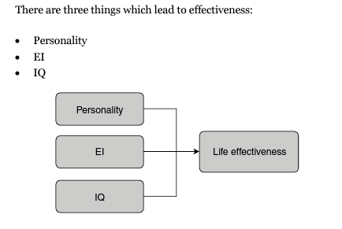

Slide 20
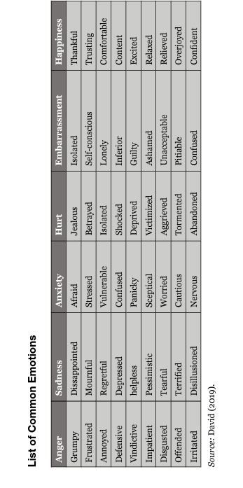

Slide 21
